Slide 1
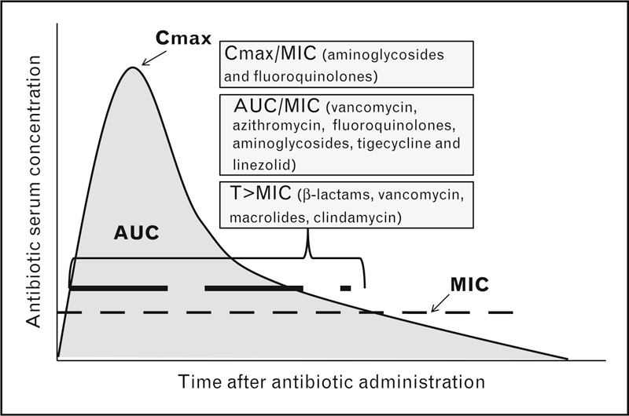
**NEW ** AUC₂₄/MIC
Vancomycin Monitoring BY Pharmacy
Providers
NEW monitoring METHOD based on updated IDSA/ASHP/PID guidelines - March 2020
TROUGH = poor surrogate for AUC/clinical efficacy in serious infections
Higher daily dose & trough levels associated with AKI
Vancomycin
  NEW TARGET – AUC₂₄/MIC 400-600 mg-hr/Liter
  AUC monitoring will require 2 POST DOSE LEVELS for some patients
  Expect HIGHER levels, 1st post dose level can be in the range of 25-40 mg/dL
  Trough results can be LOWER with AUC/MIC monitoring and still be in the therapeutic range
  Trough only monitoring will still be used for some indications:
    SSTI • AKI/rapidly changing renal function
    UTI • ESRD

Slide 2
**NEW ** AUC₂₄/MIC
Vancomycin Monitoring BY Pharmacy
Nursing
NEW monitoring vancomycin METHOD – what to expect:
Vancomycin
  AUC monitoring will require 2 POST DOSE LEVELS for some patients
    One level will be similar to a peak – 1 hour after the end of infusion
    One level before the next dose
  Expect HIGHER levels, 1st post dose level can be in the range of 25-40 mg/dL
  Trough results can be LOWER with AUC/MIC monitoring and still be in the therapeutic range
  Trough only monitoring will still be used for some indications:
    SSTI • AKI/rapidly changing renal function
    UTI • ESRD

Slide 3
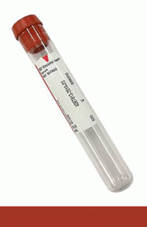

**NEW ** AUC₂₄/MIC
Vancomycin Monitoring BY Pharmacy
Lab
NEW monitoring METHOD – what to expect:
Vancomycin
  AUC monitoring will require 2 POST DOSE LEVELS for some patients
    One level will be similar to a peak – 1 hour after the end of infusion
    One level will be similar to a trough - before the next dose
  Expect HIGHER levels, 1st post dose level can be in the range of 25-40 mg/dL
  Trough results can be LOWER with AUC/MIC monitoring and still be in the therapeutic range
  Single trough only monitoring will still be used for some indications
2 Levels after 1 Vancomycin dose

